Slide 1
ACCOUNTING FOR CAPITAL PROJECTS
Financial Policies and Procedures for the Capital Project Delivery Process
Office of the CFO
Notes:
KR
s

Slide 2
Project Accounting
Kimberley Rourke
Manager, Project Accounting
Correen Baker
Fiscal Manager
Lynn Chapdelaine
Accountant
Tammie Corioso
Accountant
Notes:
KR
Introduce Staff – put faces to names
Some of us have met each other some have not
Mention Robin as having oversight of PA which includes PA as well as other responsibilities

Slide 3
Financial Policies and Procedures for the Capital Project Delivery Process
Project Initiation
Procedures for Design and Construction
Other Accounting Procedures
UCONN 2000 Project Audits
Notes:
KR
Brief Outline of what we will be talking about
Overview of all major sections to be covered in training

Slide 4
Project Initiation
Authorization of Capital Budget
Project Budget Approval
Setting Up Capital Projects
Notes:
KR
Project Initiation in detail – shows each subsection
What areas we will cover in this section

Slide 5
Procedures for Design and Construction
Prequalification
Contract Approval
Purchase Orders to Vendors
Authorizing Use of Internal Vendors
Greensheet Log
Approval and Payment of Vendor Invoices from a Purchase Order
Paying an Internal Vendor
Approval and Payment of Legal Invoices
Notes:
KR
Procedures for Design and Construction in detail – shows each subsection
What areas we will cover in this section

Slide 6
Other Accounting Procedures
Payroll Allocation
Project Financial Close-Out
Project Reporting
Notes:
KR
Other accounting procedures in detail- shows each subsection
What areas we will cover in this section
NOTE TO PRESENTER– no detail screen for UCONN 2000 audit- there are no subsections

Slide 7
Financial Policies and Procedures for the Capital Project Delivery Process
Project Initiation
Procedures for Design and Construction
Other Accounting Procedures
UCONN 2000 Project Audits
Notes:
KR
TRANSITION SLIDE

Slide 8
Authorization of the Capital Budget
Presented annually to the University’s Board of Trustees
Includes:
Proposed “named projects” with amounts, descriptions, funding analysis
Deferred Maintenance/Code/ADA Renovation Lump Sum project list
Phase III Preliminary Outline by Fiscal Year (“Phasing Outline”)
Notes:
KR
Next slides are examples
-usually June

Slide 9
Notes:
KR
This slide shows the “Proposed “named projects” list for that fiscal year with amounts and descriptions from the 6/24/08 BOT meeting
This particular list actually changed in March 2009 when we “re-phased” FY08 and FY09 due to cuts made by Governor Rell

Slide 10
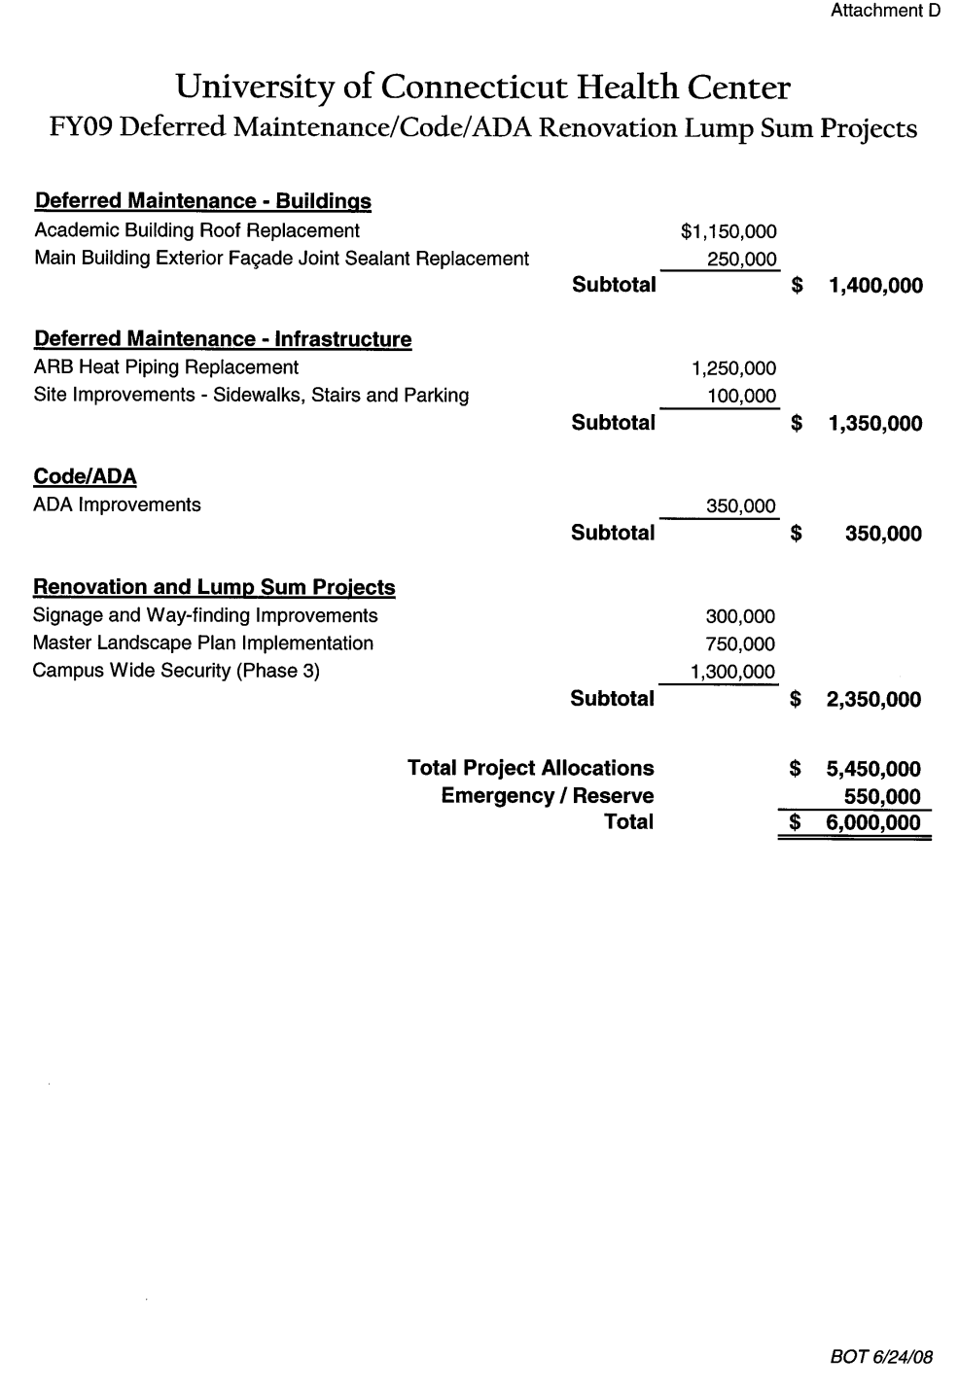
Notes:
KR
There are the two DM Code/ADA/Renovation Lump Sum Schedules- one for Storrs and one for the Health Center that went on 6/24/08 to the BOT meeting
This is the budget approval process for the DM projects listed. Only changes to project allocations or new projects need to go to the B&G for approval.

Slide 11
Authorization of the Capital Budget, cont’d.
Once the Capital Budget is approved by the BOT, a letter is sent to the Governor requesting authorization to bond
If not acted upon within 30 days, the authorization is deemed to be approved
Request amendment by General Assembly of Phase III projects list as needed
Initiate and sell Special Revenue Bonds as determined by need and approved by BOT
Notes:
KR
NOTE TO PRESENTER: Translation: I f Governor wants to disagree then she has 30 days to do so? Yes- per KR or she can sign immediately

Slide 12
Project Budget Approval
Projects ≥ $500,000 require BOT Approval at various phases:
Phase Contingency Requirement
Planning 10%
Design 8%
Final 5%
Notes:
KR

Slide 13
Project Budget Approval, Cont’d
Financial Criteria for going to BOT:
Phase Change (i.e. Planning to Design)
If total expenditures are anticipated to exceed 5% of the total budget, a revised budget must be presented to the BOT for prior approval
Administration can approve changes and expenditures up to 5% of total budget but must go back to the BOT to report the new budget
Notes:
KR

Slide 14
Project Budget Approval, Cont’d.
If “named” require approval of VP/CFO (“Child Budget”)
If Deferred Maintenance/Code/ADA/Renovation Lump Sum require approval of B&G Committee
Require approval of B&G Committee
Projects < $500,000
Department funded projects ≥ $50,000
Notes:
KR
Refer to purple named project approval sheet for projects under $500,000 (should include in handouts)
Briefly describe B&G committee

Slide 15
Project Budget Approval, cont’d.
Plant Accounting Role/Tasks:
Review BOT/VP-CFO budgets for funding, adherence to policies
Review B&G approved action items
Assign project numbers and update FRS/FAMIS as approvals are given
Notes:
KR
Describe process of assigning projects numbers and impact on FRS system
Emphasize importance of Project name protocol and funding?
Go over need to avoid terminating projects and/or combining them?
Let them know we get info into FRS and FAMIS asap

Slide 16
Setting Up Capital Projects
Projects are set up through the following actions:
BOT approvals of projects ≥ $500,000
VP-CFO approvals of “named” projects < $500,000
Deferred Maintenance/Code/ADA/Renovation Lump Sum project list approved at annual BOT meeting
Changes to the DM list by B&G (allocations from reserves)
Department/Foundation funded projects ≥ $50,000 approved by the B&G
Department/Foundation/University Funded projects < $50,000 as requested
Notes:
KR
Recall the different types of Board Approvals
Emphasize need for the items prior to setting up project –official project name, funding source, Request Budget ASAP
Should we go over “as requested” limitations on the last bullet? – Lynn C will provide criteria for UC project
(ask Lynn C)
Should we discuss allocations from DM Reserves? -

Slide 17
Setting Up Code Projects
All requests must go through Brian Gore, Director of Project and Program Management
Naming Convention for Code Projects:
STIF-Interest Funded (if original building was built by UConn 2000):
UCONN 2000 Code Remediation – (Building Name)
DM Funded (OSFM/UCFM on non-UConn 2000 built buildings):
OSFM or UCFM Code Remediation – (Building Name)
Notes:
KR

Slide 18
Setting Up Capital Projects, cont’d.
Plant Accounting Role/Tasks:
Assign project numbers
Assign FRS accounts by type of funding
Move funding into projects in FRS
Enter project in FAMIS including description, budget, funding.
Encumber funding if Foundation funded
Notify appropriate parties of project numbers, descriptions, accounts, amounts via email
Notes:
KR
Budgets are supplied to Plant Accounting by AES/CPCD- EMPHASIZE we need these budgets to be able to input
Should we discuss, the Foundation mechanics- Basics: Has to be set up before we can proceed

Slide 19
Financial Policies and Procedures for the Capital Project Delivery Process
Project Initiation
Procedures for Design and Construction
Other Accounting Procedures
UCONN 2000 Project Audits
Notes:
KR

Slide 20
Procedures for Design and Construction, cont’d.
Prequalification
Purpose: To evaluate and select contractors who will be invited to bid on projects
Plant Accounting Role/Tasks:
Assess the financial capability of vendors to complete a project
Accept/Reject based on financial ratios and industry standards
Provide worksheets to evaluation committee
Notes:
KR - note: for CPCA we should expand this section
For presenter reference if needed:
Prequal per CPCA website is done when:
All projects with a construction value estimated to be $500,000 or more require interested applicants to be prequalified. All interested firms must first be DAS (Department of Administrative Services) Prequalified as well as Prequalified with the University for specific projects.
All projects with a construction value estimated to be less than $500,000 and are being bid as a Lump Sum General Contractor or Subcontractor Selection Process, require a submission of a prequalification survey (AIA A305) with each firms bid.
PA uses - job specifications such as length of job and expected cost
- industry standard ratios
- financial data from contractors financial statements to calculate ratios
For CPCA presentation we should go into more detail to review two week requirement for turnaround and difference of Financial Statements, annual cycle, audit versus review, interims- all date requirements
Discuss follow ups on interim statements
Will complete when all items are received or notice that item will not be received
PA should not have contact with contractor

Slide 21
Procedures for Design and Construction
There are two main forms used to initiate a purchase order:
Contract Approval Request (CAR)
This form is used for any new contract
Approval of Change to Original Contract, Work Plan or Purchase Order Request” (GREENSHEET)
-this form is used for all other purchase orders, changes or any other financial commitments
Notes:
CB

Slide 22
Procedures for Design and Construction
Contract Approval
Purpose: To ensure that all phases of engaging an architect or construction contractor are in accordance with University and State regulations.
Contract is routed with CAR – Contract Approval Request
CAR is signed by:
CPCA
AES/UCHC CPDC
Plant Accounting
VP-COO
Notes:
CB

Slide 23
Notes:
Printscreen of a CAR
Two signatures at bottom are Tom Callahan and Barry Feldman

Slide 24
Purchase Orders to Vendors
Purpose: To establish a commitment or encumbrance against an approved project.
“Approval of Change to Original Contract, Work Plan or Purchase Order Request” (GREENSHEET)
GREENSHEET is signed by:
AES/UCHC Project Managers
Director
Plant Accounting
AVP
CPCA
Notes:
CB

Slide 25
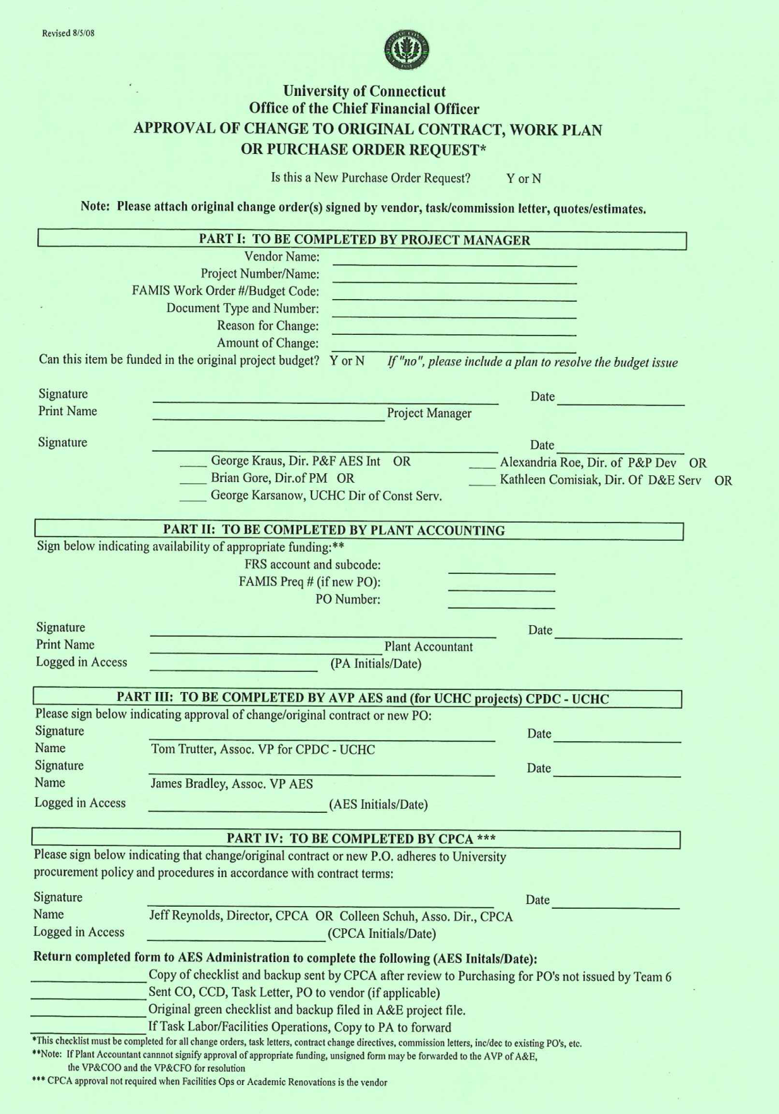
Notes:
CB
3 exceptions when no greensheet is required but there must budget for:
1% Management Fee
Advertising
Reproduction
Backup documents include: vendor quotes/proposals, tasks letters for on call contracts, and construction change orders – not a PA role to make sure appropriate documentation is attached Role is Financial
Need Budget code line, create WO number if needed

Slide 26
Purchase Orders to Vendors, Cont’d.
Plant Accounting Role/Tasks:
Verify UCONN2000 funding has been approved and/or non-UCONN2000 funding is in place and that the commitment falls within the contract budget
Evaluate the request against the line item of the project budget, contingency and budget as a whole
Work with AES/UCHC CPDC if there is a budget/funding issue
Enter the revised budgets from PM in FAMIS if applicable
Enter purchase requisitions or changes into FAMIS
Enter information into GREENSHEET Log
Notes:
CB
Now for both the CAR and the greensheet
(Problems encountered)
Again, it is very helpful if you give me a budget code
FAMIS is not very user friendly for edits
WORKORDER-BUDGET LINE

Slide 27
Authorizing Use of Internal Vendors
Purpose: To establish an approval process for the use of internal vendors on capital projects.
Internal Vendors include:
Facilities Operations
Locksmith
Police/Fire (Public Safety)
Other internal departments
Prior approval is required by routing an estimate of the cost of work attached to a GREENSHEET checklist
If the actual charges exceed the original estimate, an additional GREENSHEET should be routed to authorize the increase
Notes:
CB

Slide 28
Authorizing Use of Internal Vendors, Cont’d.
Plant Accounting Role/Tasks:
Ensure that funding is in place
Evaluate the request against the line item of the project budget, contingency and budget as a whole
Work with AES/UCHC CPDC if there is a budget/funding issue
Sign the GREENSHEET
Enter the revised budgets from PM in FAMIS, if applicable
Create a workorder in FAMIS and enter the estimate amount. This amount will show up in the allocated column on the budget cost summary screen in FAMIS
Facilities Operations workorders are issued by their Workorder Department. The estimate amount is then entered on the workorder and will then show up as a commitment
Enter information into GREENSHEET Log
Notes:
CB
Facilities enters estimate
As facilities/labor/ post against workorder the commitment will be reduced and the expenditure will go up but this does not mean that the project account has been charged – this will not occur until it is approved by the PM

Slide 29
GREENSHEET Log
Purpose: Collaboration between AES and PA to establish method of keeping track of GREENSHEETS
Resides on the public drive at AES accessible to PA, AES and CPCA
Plant Accounting Role/Tasks:
Enter GREENSHEET into Log
Enter date of approval into log
Notes:
CB
To obtain access to the Greensheet log- contact Jessica.
(remove slide for Health Center presentation)
BREAK

Slide 30
Approval and Payment of Vendor Invoices from a Purchase Order
Vendors’ original invoices are received by or forwarded to PA located in AES
Invoices are attached to “Approval for Payment” Checklist (GOLDENROD)
Generally, Plant Accounting initiates GOLDENRODS
GOLDENROD is signed by:
PA
AES/UCHC CPCD Project Manager
their Director
AVP of AES
AVP of UCHC (if applicable)
Notes:
TC
Hi- I am going to be speaking about goldenrods
First I will describe a general goldenrod then cover some of the exceptions
As you know any invoices to pay for any encumbrance with a greensheet needs a goldenrod
In general ,when a Purchase Orders is set up, a copy of the po is sent to the vendor and on the po are directions to have invoices sent to the Plant Accountant in the A&E building.
(Read slides)

Slide 31
Approval and Payment of Vendor Invoices from a Purchase Order, Cont’d.
Plant Accounting Role/Tasks:
Generate a GOLDENROD checklist
Check that valid PO is in place in the correct project, date stamp invoice, and stamp with “Goods and Services” (red) stamp, record PO #, Project # on invoice
Sign the GOLDENROD and attach appropriate backup (FRS screen prints)
Enter invoice into FAMIS and log to AES (PM, Date)
After signatures are obtained, check for completeness including authorized signature on “Goods and Services” (red) stamp
Log date sent to Accounts Payable into FAMIS
Forward invoice packet to AES for copying and sending (original invoice) to AP
Notes:
TC
Read slides
At end:
If there are errors on a bill that are easily detectable I will try to point them out – such as retainage. However, when there are issues with invoices it is the Project Managers role to contact their contact person and resolve the issues such as: incorrect retainage, work was not done, etc.
if you decide you need to hold onto the invoice please let me know and I can make a notation in FAMIS- this will allow me to answer questions if the vendor’s accounts receivable department calls me asking about bill payment.
Also- if you notice that the project number or PO number is not listed please let your vendor contact know to add it to the invoice

Slide 32
Notes:
TC
Here is a goldenrod
Signatures are in order

Slide 33
Paying an Internal Vendor
2 methods of tracking costs for internal vendors:
Internal Vendor issues a PO
Academic Renovations
Uconnect
2. Internal Vendor accumulates costs in their own accounts and “bills” projects
Facilities Operations
Locksmith
Police/Fire (Public Safety)
Notes:
TC
As a reminder:
All work needs pre approval using greensheet checklist
All payments need pre approval using a goldenrod checklist

Slide 34
Paying an Internal Vendor, Cont’d.
Plant Accounting Role/Tasks:
For internal vendors charging projects from their own accounts (except Facilities):
Verify encumbrance by GREENSHEET.
Generate GOLDENROD with detailed charges from internal vendor attached
Once GOLDENROD is routed and approved, prepare journal entry to charge project
Notes:
TC
Examples are Locksmith and Police and Fire Watch
For internal vendors with Pos- handle just like any other invoice with a goldenrod – this would be Academic Renovations and UConnect

Slide 35
Paying an Internal Vendor, Cont’d.
Plant Accounting Role/Tasks:
For Facilities:
Verify encumbrance by GREENSHEET.
Generate GOLDENROD with detailed invoice(s) attached
Check to make sure charge is within budget or estimate originally provided
Once GOLDENROD is approved, notify Facilities that invoice can be taken off “Accounting Hold” and billed to the project
Notes:
TC
If charge is over the budget an additional greensheet is required
Facilities charges are not technically approved until PA approves thate the goldenrod has been signed off properly

Slide 36
Approval and Payment of Legal Invoices
Vendors’ original invoices are received by or forwarded to PA located in AES and are attached to an “Approval for Payment of Legal Invoice” GOLDENROD.
GOLDENROD is signed by:
PA
AES/UCHC CPCD Project Manager
their Director
AVP of AES
AVP of UCHC (if applicable)
CFO
Notes:
TC – For A&E presentation:
Only difference is signature by CFO at bottom
NOTE- invoices are received by CPCA initially- forwards project invoices to PA
Procedure for Initiation of Purchase Orders to Gordon, Muir & Foley
In the initiation stage of a capital project (bid advertising is beginning and/or legal counsel needs to be engaged), a PO will be initiated by Capital Projects and Contract Administration (CPCA) using the "greensheet" checklist form.
CPCA will initiate the green sheets based on the chart below for all projects with the exception of code remediation projects.
Estimate of Legal Fees by Project Type for PO Initiation
Legal
Project Type Counsel Totals
UC2000 < $500,000 GM&F 2,000.00
UC2000 > $500,000 GM&F 5,500.00
Monthly invoices are received by CPCA.
CPCA initiates increases as needed.
CPCA forwards invoices for projects to Plant Accounting.

Slide 37
Approval and Payment of Legal Invoices, Cont’d.
Plant Accounting Role/Tasks:
Generate a GOLDENROD checklist
Check that valid PO is in place in the correct project, date stamp invoice, and stamp with “Goods and Services” (red) stamp, record PO #, Project # on invoice
Log invoice in FAMIS as sent to AES (PM, date)
Once approvals are received, checklist returned to PA to verify signatures and stamp is signed by authorized person
Log invoice as sent to AP with date
Invoice is given to AES to send to AP
Notes:
TC
These are the same steps as for a regular goldenrod with the added step of the signature on the bottom-
DO NOT READ WHOLE SLIDE

Slide 38
Notes:
TC
Example of legal goldenrod
NOTE different from regular Goldenrod as the CFO signature is added at the bottom
Please review legal bills in detail so that you are comfortable with the work being done

Slide 39
Financial Policies and Procedures for the Capital Project Delivery Process
Project Initiation
Procedures for Design and Construction
Other Accounting Procedures
UCONN 2000 Project Audits
Notes:
TC

Slide 40
Payroll Allocation
Purpose: To charge salaries and fringes to projects for designated employees in AES, CPCA and the Office of the CFO
Method: Allocate 1% of the total costs for that project for each fiscal quarter
Plant Accounting Role/Tasks:
Calculate amount of payroll to allocate to projects quarterly based on project expenses
Generate a journal entry to move payroll expenses into projects
Record payroll expense allocated for the quarter in FAMIS as miscellaneous costs
Notes:
KR
General Rule of Thumb: Payroll expense is applied at 1% of expenses incurred in the prior quarter
Field questions
Change in procedure was at 7/01/07- some projects initiated prior to that date may have greater than 1% based on policy an procedures at that time.
Remember- when you increase or decrease a project budget, adjust for payroll.

Slide 41
Project Financial Close-Out
Performed when a project is near substantial completion
Return unspent funding as follows:
Non-Bond funds to the originating source accounts
Deferred Maintenance is returned via the B&G Committee
“Named” project funding is reallocated and the indenture change approved by BOT
Notes:
CB

Slide 42
Project Financial Close-Out, Cont’d
Plant Accounting Role/Tasks:
Identify projects ready for financial close-out
Reconcile FRS to FAMIS
Review payroll allocation amount – 1% of Expenses
Close all PO’s/Contracts (using GREENSHEET process)
Return unspent funding
Change project status in FAMIS to “Financial Closeout”
Change status of FRS accounts to “Frozen”
Notes:
KR
Request by a PM
Email from PM
Final Payment
DM closeouts
DM completions
For DM – GK notifies us
“named” - AES PM
Other no expense/encumbrance activity in past year
Need input from CB

Slide 43
Project Reporting
Reports Presented to the BOT:
UConn 2000 Phase III Preliminary Outline by FY (Phasing Outline).
Annual Capital Budget
Annual Deferred Maintenance/Code/ADA/Renovation Lump Sum Project list
Deferred Maintenance Total Expenditure Report (Annual)
Equipment Total Expenditure Report (Annual)
Master Schedule for UConn 2000 Phases I, II & III Working Draft (Quarterly) – “Mother Report”
Construction Status Report (all meetings)
Supplemental Indentures Authorizing General Obligation Bonds (as needed)
Project Budgets (as needed)
Notes:
KR
UConn 2000 Phase III Preliminary Outline by FY (Phasing Outline) – HOLD UP
Annual Capital Budget -IN PRESENTATION
Annual Deferred Maintenance/Code/ADA/Renovation Lump Sum list -IN PRESENTATION
Deferred Maintenance Total Expenditure Report (Annual)
Equipment Total Expenditure Report (Annual)
Master Schedule for UConn 2000 Phases I, II & III Working Draft (Quarterly) -HOLD UP MOTHER REPORT
Construction Status Report (all meetings) - HOLD UP
Supplemental Indentures Authorizing General Obligation Bonds (as needed)
Project Budgets (as needed) -IN PRESENTATION
REFERENCE WEBSITE-next slide

Slide 44
Notes:
KR
Capital Projects Delivery Procedures Manual
Construction Status Report
BOT Budgets

Slide 45
Project Reporting, Cont’d.
Reports presented to the B&G:
UConn 2000 Deferred Maintenance/Code/ADA Renovation Lump Sum Project List by Fiscal Year
Non-UConn 2000 Projects Approved by B&G
Notes:
KR
hold them up
If you are interested we can send you the reports

Slide 46
Project Reporting, Cont’d.
Reports presented to the UConn 2000 Workgroup Meeting:
Monthly UConn 2000 Cash Flow
Selected Project Estimated Cost to Complete Reports
Special reporting as needed
Notes:
KR
hold them up
If you are interested we can send you the reports

Slide 47
Financial Policies and Procedures for the Capital Project Delivery Process
Project Initiation
Procedures for Design and Construction
Other Accounting Procedures
UCONN 2000 Project Audits
Notes:
KR
Transition Slide

Slide 48
UCONN 2000 Project Audits
There are currently 3 separate groups auditing
UCONN 2000 projects:
Independent accounting firm is engaged to do an audit of projects substantially complete during previous fiscal year
State of Connecticut Auditors of Public Accounts
Office of Audit, Compliance and Ethics (Internal Audit)
Notes:
KR
UHY- why here what there role is
State of CT Auditors - Michelle Cosgrove and Greg-
Internal Audit – Cheryl Chapuitti

Slide 49
UCONN 2000 Project Audits, Cont’d.
Independent accounting firm audits the following:
All “named” projects and/or DM/Code/ADA ≥ $500,000
Agreed Upon Procedures – audit of the current year’s Uconn 2000 expenses
Notes:
KR

Slide 50
UCONN 2000 Project Audits, Cont’d.
Plant Accounting Role/Tasks:
Develop list of projects to be audited each FY
Provide detailed expense analysis for projects selected
Provide direction on finding source documentation
Attend audit status meetings
Resolve issues
Provide special reporting
Notes:
KR

Slide 51
http://www.cfo.uconn.edu/UCONN2000.html
QUESTIONS?
Notes:
Here is the website to access the manual

